Slide 1
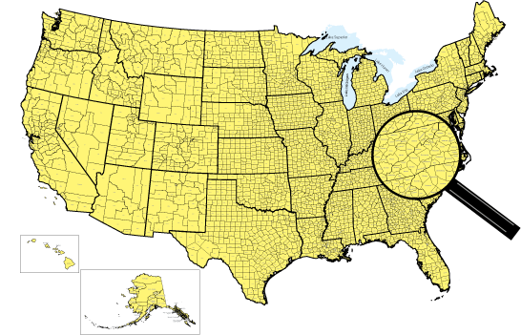
From Urban to Rural: How Disability Rates Shift by Region
Najla Muhammad | June 16, 2025 | ASRI 2025
Master of Health Informatics | Wake Forest University
START HERE
Notes:
Welcome everyone and thank you for joining me today. My name is Najla Muhammad and I will be presenting my project titled: “”. By the end, you’ll have a clear understanding of how disability rates vary by geographic location and what this means for public health.

Slide 2
Introduction
Prevalence
Rural counties: Higher disability rates (all ages)
Urban counties: Lower disability rates
Causes & Types
Types: Developmental, mobility, sensory, cognitive, self-care
Causes: Isolation, less healthcare/education, poverty, transport
Implications
Trends: Disparity across ages
Needs: Better health, education, and support in rural areas
Notes:
Today, I’d like to provide an overview of disability prevalence and its importance in public health. Disability prevalence refers to the proportion of individuals in a population who report having a disability, and it is a key indicator for understanding community health needs. Health disparities—especially between rural and urban areas—are a major public health concern, and rural communities often face unique challenges that can impact health outcomes.
Research shows that adults in the most rural counties are 9% more likely to report any disability and 24% more likely to report three or more disabilities compared to those in large central metropolitan counties. This highlights a significant gap in health status between these populations. Furthermore, rural residents are more likely to experience all types of disabilities, including difficulties with hearing, vision, cognition, mobility, self-care, and independent living.
Several factors contribute to these disparities. Geographic isolation, limited access to healthcare, transportation barriers, higher rates of poverty, and fewer employment opportunities all play a role in the higher disability rates observed in rural areas. These challenges can create a cycle of disadvantage, making it harder for rural residents to access the services and support they need.
Understanding and addressing these disparities is important because it informs where resources should be directed and how public health interventions can be tailored to meet the needs of different communities.
The main objective of this study is to compare disability rates across different county types, using established classifications such as the Rural-Urban Continuum Codes (RUCC). By doing so, we can identify which communities are most at risk and begin to address the underlying factors that contribute to these health disparities

Slide 3
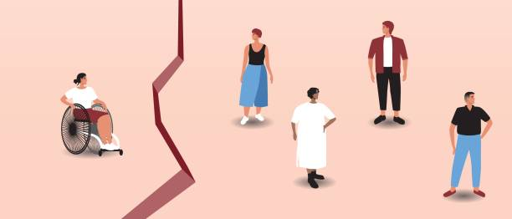
Hypothesis
Are counties classified as more rural more likely to have higher disability prevalence rates than urban counties?
Hypothesis: Counties with lower populations are more likely to have higher disability rates.
Null hypothesis (H₀): There is no difference in the mean disability rates among the county types.
Notes:
This leads me to my research question: “Are counties classified as more rural more likely to have higher disability prevalence rates than urban counties?” My hypothesis is that rural counties—especially those in the most remote categories—will indeed show higher disability prevalence rates compared to urban areas. This is based on prior research, which consistently finds that rural communities face greater health challenges and have higher rates of disability.
To test this hypothesis statistically, I set up a null hypothesis stating that there is no difference in the mean disability prevalence rates among the different county types, as defined by the RUCC classification. My analysis will determine whether the data support rejecting this null hypothesis in favor of the alternative—that rural counties have higher disability rates.

Slide 4
Methods
Statistical Analysis
Python
Dataset
PLACES County Data, 2024 release
2023 Rural-Urban Continuum Codes
Pandas: EDA & data cleaning
Seaborn & Matplotlib: Data visualization
ANOVA
Notes:
For this analysis, I used the CDC PLACES dataset as well as the 2023 Rural-Urban Continuum Codes, also called RUCC. I used Python to process and visualize the data. Pandas was used for exploratory data analysis and data cleaning. Seaborn and Matplotlib were used to create visualizations.
I performed an ANOVA to test whether there were significant differences in mean disability prevalence across RUCC categories. Why? ANOVA is designed for comparing means across 3 or more groups. Tests whether at least 1 group is significantly different from the others.

Slide 5

Data & Variables: Rural-Urban Continuum Codes
RUCC | Description
1 | Metro - Counties in metro areas of 1 million+ population
2 | Metro - Counties in metro areas of 250,000 to 1 million
3 | Metro - Counties in metro areas of fewer than 250,000
4 | Nonmetro - Urban population of 20,000+, adjacent to metro
5 | Nonmetro - Urban population of 20,000+, not adjacent to metro
6 | Nonmetro - Urban population of 2,500 to 19,999, adjacent to metro
7 | Nonmetro - Urban population of 2,500 to 19,999, not adjacent to metro
8 | Nonmetro - Completely rural or <2,500 urban, adjacent to metro
9 | Nonmetro - Completely rural or <2,500 urban, not adjacent to metro
Notes:
The RUCC classification system divides counties into nine categories, ranging from large metropolitan areas to rural nonadjacent counties. Each category is defined by population size and proximity to urban centers. For example, category 1 includes counties in metro areas with over a million people, while category 9 includes rural counties not adjacent to any metro area. This classification is useful because it allows us to compare health outcomes across different levels of urbanicity and rurality. For this analysis, we are going to focus on the last 2 categories, 8 & 9.
The County Types are categorized by Rural-Urban Continuum Codes

Slide 6

Data & Variables: Variables
Independent Variable (x): County Type
Categorical > represents rural or urban counties.
Dependent Variable (y): Disability Prevalence
Continuous > represents prevalence of individuals with disabilities (as a percentage or rate).
Notes:
The key variables in this analysis are disability prevalence and county type. Disability prevalence is the percentage of individuals with a disability in each county, and county type is determined by the RUCC category. I also used population size from the PLACES dataset. These variables allowed me to conduct statistical tests and create visualizations that highlight differences in disability rates across county types.

Slide 7

Results: ANOVA
Source | df | SS | F | p-value
RUCC (or County Types) | 1.779257e+08 | 8.0 | 75.369488 | 1.566072e-124 or < 0.001
Residual | 2.464378e+10 | 83513.0
Notes:
The ANOVA results showed a statistically significant difference in disability prevalence across county types. This means that disability rates are not the same in all counties, and the differences are unlikely to be due to random chance. The extremely small p-value (p < 0.001) indicates significant differences in disability counts across RUCC categories.

Slide 8
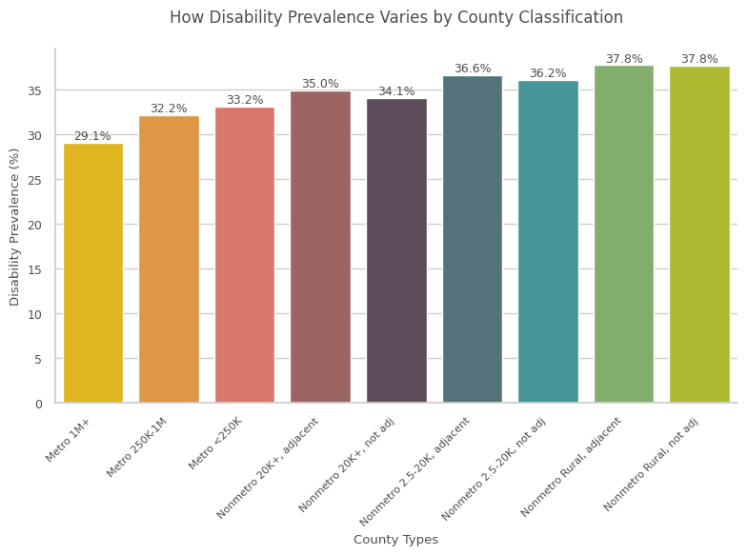
Notes:
Specifically, rural nonadjacent counties had the highest disability prevalence, while large metropolitan counties had the lowest. This means that the null hypothesis is REJECTED.
These findings are consistent with previous research and highlight the need for targeted public health strategies in rural areas. The higher prevalence in rural areas may be due to a combination of demographic, socioeconomic, and access-related factors.

Slide 9
Conclusion
Higher disability prevalence in rural areas
Implications: Greater health burdens in rural communities
Recommendations:
Increase funding
Expand telehealth
Address poverty
Monitor rates
Notes:
Summary of Findings:
Our analysis found significant differences in disability prevalence across county types, with rural counties—particularly those classified as nonmetro or rural nonadjacent—showing higher rates of disability than urban counties. This pattern was consistent with previous research and highlights the persistent health disparities between rural and urban communities.
Implications:
The results have important implications for public health policy and practice. Higher disability prevalence in rural areas suggests that these communities face greater health burdens and may have less access to the resources needed to support people with disabilities. Factors such as geographic isolation, limited healthcare access, transportation barriers, higher poverty rates, and fewer employment opportunities all contribute to these disparities. Addressing these challenges is essential for promoting health equity and improving quality of life for all residents.
Recommendations:
To address these disparities, several strategies can be considered:
Targeted Public Health Interventions:
-Develop and implement programs specifically designed for rural communities, focusing on prevention, early detection, and management of disabilities.
-Increase funding and resources for rural health initiatives.
Improve Access to Healthcare:
-Expand telehealth services to overcome geographic barriers.
-Support the recruitment and retention of healthcare professionals in rural areas.
Address Social Determinants of Health:
-Invest in transportation infrastructure to improve access to healthcare and community services.
-Implement economic development programs to reduce poverty and increase employment opportunities.
Monitor and Evaluate Progress:
-Continue to monitor disability prevalence and related health outcomes in rural and urban areas.
-Use data to inform policy decisions and evaluate the effectiveness of interventions.
Closing:
By understanding and addressing the factors that contribute to higher disability prevalence in rural areas, we can work toward reducing health disparities and ensuring that all communities have the opportunity to thrive.

Slide 10

THANK YOU
Presentation Template: SlidesMania
LinkedIn | Email

Slide 11
References
Centers for Disease Control and Prevention. (2024). PLACES: Place data (GIS friendly format), 2024 release. https://data.cdc.gov/500-Cities-Places/PLACES-Place-Data-GIS-Friendly-Format-2024-release/vgc8-iyc4/about_data
Felter, C. E., Zalewski, K. R., Jermann, R., Palmer, P. L., Baier, A. E., & Falvey, J. R. (2022). Rural Health: the Dirt Road Less Traveled. Physical Therapy, 102(11). https://doi.org/10.1093/ptj/pzac112
Lu, H., Wang, Y., Liu, Y., Holt, J. B., Okoro, C. A., Zhang, X., Zhang, Q., & Greenlund, K. J. (2023). County-Level Geographic Disparities in Disabilities Among US Adults, 2018. Preventing Chronic Disease, 20. https://doi.org/10.5888/pcd20.230004
Sage, R., Ward, B., Myers, A., & Ravesloot, C. (2019). Transitory and Enduring Disability Among Urban and Rural People. Journal of Rural Health, 35(4), 460–470. https://doi.org/10.1111/JRH.12338
U.S. Census Bureau. (2023, June 29). Disability rates higher in rural areas than urban areas. https://www.census.gov/library/stories/2023/06/disability-rates-higher-in-rural-areas-than-urban-areas.html
U.S. Department of Agriculture, Economic Research Service. (2023). Rural-urban continuum codes. https://www.ers.usda.gov/data-products/rural-urban-continuum-codes
Notes:
Felter, C. E., Zalewski, K. R., Jermann, R., Palmer, P. L., Baier, A. E., & Falvey, J. R. (2022). Rural Health: the Dirt Road Less Traveled. Physical Therapy, 102(11). https://doi.org/10.1093/ptj/pzac112
The paper highlights that rural-dwelling older adults face more chronic health conditions and greater medical vulnerabilities, contributing to increased disability rates in these communities.
Lu, H., Wang, Y., Liu, Y., Holt, J. B., Okoro, C. A., Zhang, X., Zhang, Q., & Greenlund, K. J. (2023). County-Level Geographic Disparities in Disabilities Among US Adults, 2018. Preventing Chronic Disease, 20. https://doi.org/10.5888/pcd20.230004
This paper supports the claim that adults in rural areas have a higher prevalence of disabilities compared to urban areas. The study found that prevalence increased for hearing disability and any disability with county rurality, indicating significant geographic disparities in disability rates.
Sage, R., Ward, B., Myers, A., & Ravesloot, C. (2019). Transitory and Enduring Disability Among Urban and Rural People. Journal of Rural Health, 35(4), 460–470. https://doi.org/10.1111/JRH.12338
rural people report disability at higher rates than urban people across nearly all age categories, gender, and racial combinations, with the disparity being more pronounced for nonwhite respondents in middle to older age categories.

